Slide 1



Welcome you all
Course: CSS
CSS Outline
M.Chitradev.

Slide 2
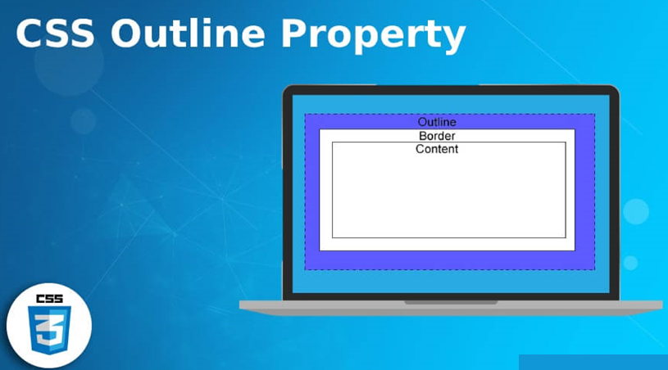

Slide 3
CSS Outline Properties
The CSS outline properties allow you to define an outline area around an
element's box.
An outline is a line that is drawn just outside the border edge of the elements. Outlines are generally used to indicate focus or active states of the elements such as buttons, links, form fields, etc.
The following section describes how to set the style, color, and width of the outline.

Slide 4
Different Outline Styles
The outline-style property sets the style of an element's outline such
as: solid, dotted, etc.
The outline-style property can have one of the following
values: none, solid, dashed, dotted, double, inset, outset, groove, and ridge.

Slide 5
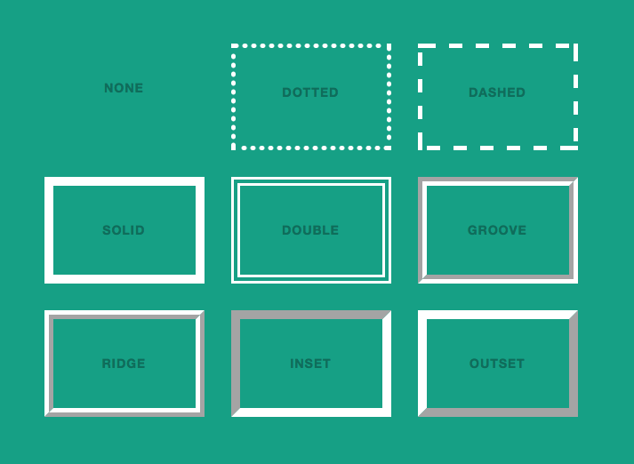

Slide 6
h1 {
outline-style: dotted;
}
p {
outline-style: ridge;
}

Slide 7
Outline Width
The outline-width property specifies the width of the outline to be added on an element.
p {
outline-style: dashed;
outline-width: 10px;
}

Slide 8
outline-width: 12px;
outline-width: thin;
outline-width: medium;
outline-width: thick;

Slide 9
Outline Color
The outline-color property sets the color of the outline.
This property accepts the same values as those used for the color property.
p {
outline-style: solid;
outline-color: #0000ff;
}

Slide 10
outline-offset
The outline-offset CSS property sets the amount of space between an outline and the edge or border of an element.
outline-offset: 4px;
outline-offset: .6rem;
outline-offset: 12px; outline: 5px dashed blue;
<p>Gallia est omnis divisa in partes tres.</p>
p {
outline: 1px dashed red;
outline-offset: 10px;
background: yellow;
border: 1px solid blue;
margin: 15px;
}

Slide 11
outline: solid;
outline: dashed red;
outline: 1rem solid;
outline: thick double #32a1ce;
outline: 8px ridge rgba(170, 50, 220, .6); border-radius: 2rem;
<a href="#">This link has a special focus style.</a>
a {
border: 1px solid;
border-radius: 3px;
display: inline-block;
margin: 10px;
padding: 5px;
}
a:focus {
outline: 4px dotted #e73;
outline-offset: 4px;
background: #ffa;
}

Slide 12
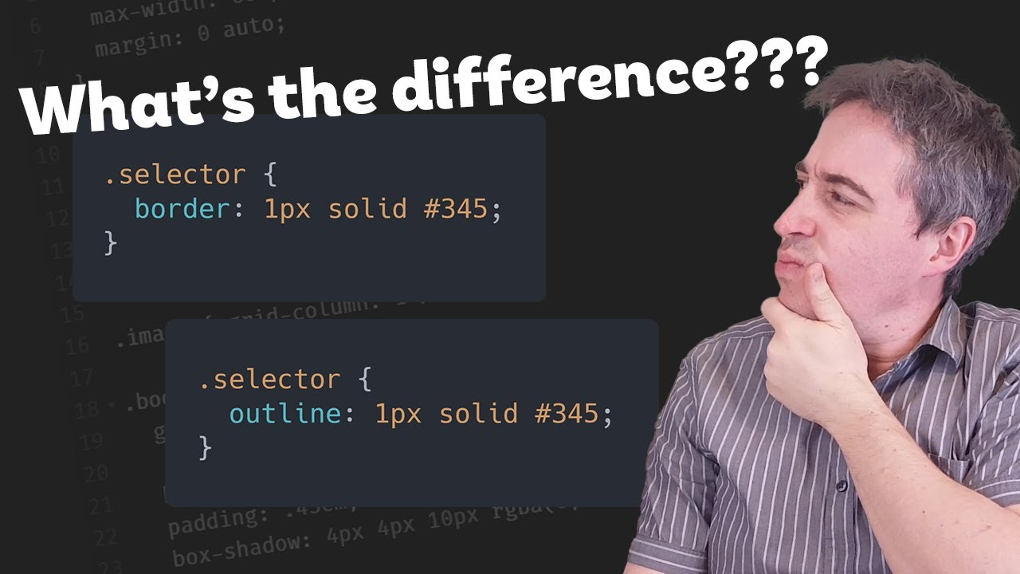

Slide 13
Outlines Vs Borders
An outline looks very similar to the border, but it differs from border in the following ways:
Outlines do not take up space, because they always placed on top of the box of the element which may cause them to overlap other elements on the page.
Unlike borders, outlines won't allow us to set each edge to a different width, or set different colors and styles for each edge. An outline is the same on all sides.
Outlines do not have any impact on surrounding elements apart from overlapping.
Unlike borders, outlines do not change the size or position of the element.
Outlines may be non-rectangular, but you cannot create circular outlines.

Slide 14

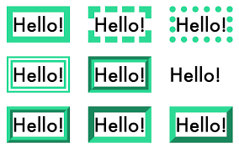

Slide 15


Slide 16

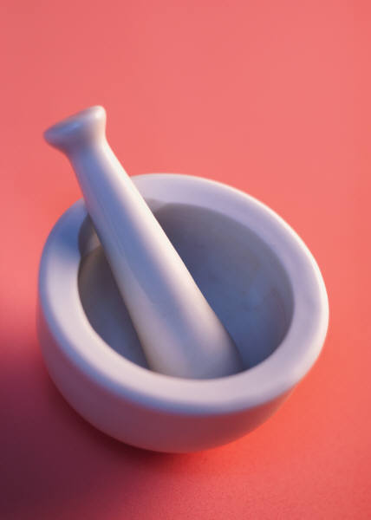

Thank You

